Slide 1
Chapter 8
Political Parties
American Democracy Now, 7th edition
Brigid Callahan Harrison
Jean Wahl Harris
Michelle D. Deardorff
Copyright 2022 © McGraw Hill LLC. All rights reserved. No reproduction or distribution without the prior written consent of McGraw Hill LLC.

Slide 2
Are Political Parties Today in Crisis?
Political party: an organization of ideologically similar people that nominates and elects its members to office in order to run the government and shape public policy.
Parties identify potential candidates, nominate them to run for office, campaign for them, organize elections, and govern.
In recent years, both parties have struggled to win the approval of the American people.
Reflects deep divisions, where a lack of respect for the other side characterizes many people’s views.

Slide 3
A Democratic Party Struggling to Evolve
In 2016, the more moderate front-runner in the Democratic Party’s presidential primary faced formidable opposition from the left wing of the party.
Hillary Clinton was viewed as the moderate standard-bearer.
Senator Bernie Sanders, who characterizes himself as a Democratic Socialist, attracted a great deal of support, especially among the young.
Party will continue to try to identify ideas, messages, and personalities that will resonate with voters.
Their approval rating remains below 50 percent.

Slide 4
The Republican Party in the Era of President Trump
Republican Party has struggled to win the public’s approval for more than a decade.
Approval rebounded somewhat with the election of Donald Trump but still hovers between 35 percent and 45 percent.
One problem is increasing factionalization.
Increasing conservatism and the Tea Party movement have often prevented compromise.
President Trump’s derogatory rhetoric disparaging various groups is seen as a rejection of the big tent principle that had previously been a successful strategy for the party.

Slide 5
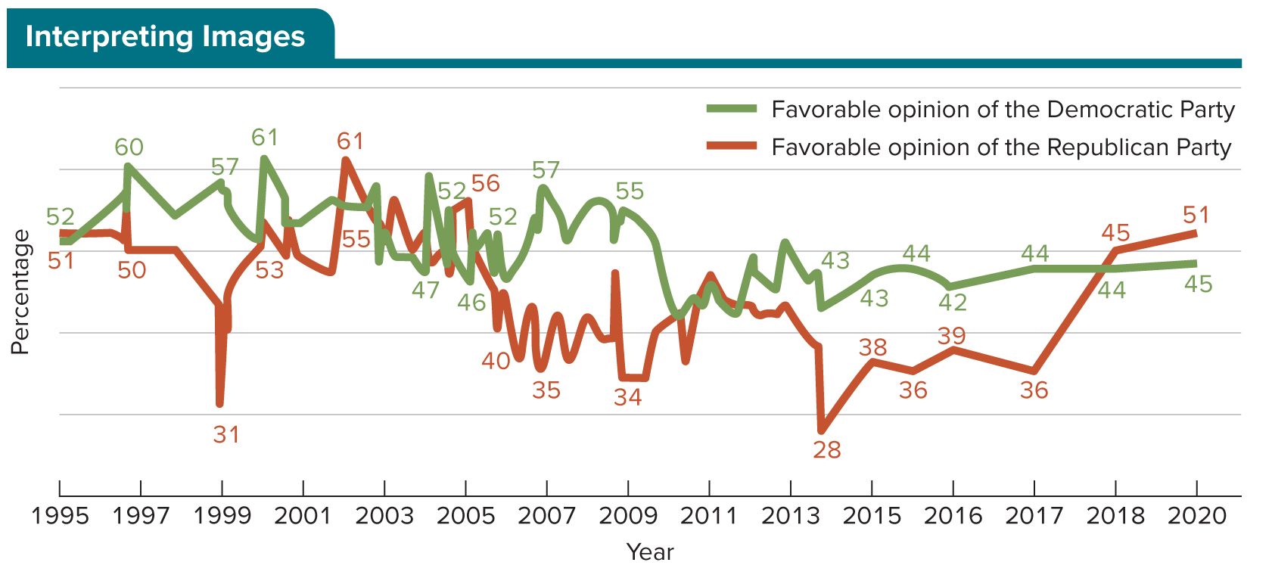
Figure 8.1 The People’s Opinion of Democrats and Republicans
The figure shows the percentage of survey respondents who have a favorable view of the Republican and Democratic Parties between 1997 and 2020.
Access the text alternative for slide images.
SOURCE: Gallup, “Party Images,” 2020.

Slide 6
Parties Today and Their Functions
Parties differ from other political organizations.
They run candidates under their own label, or affiliation.
They seek to govern.
They have broad concerns, focused on many issues.
They are quasi-public organizations that have a special relationship with the government.
Party platform: the formal statement of a party’s principles and policy objectives.

Slide 7
How Parties Engage Individuals
Political parties represent one of the main channels through which citizens can make their voices heard.
Parties today are a fixture in the politics of American communities large and small, accessible to virtually everyone.

Slide 8
What Political Parties Do 1
Grassroots organizing: tasks that involve direct contact with voters or potential voters.
Parties provide a structure for citizens to:
Volunteer on party-run campaigns.
Make campaign contributions.
Work in the day-to-day operations of the party.
Run for office.
Parties foster cooperation between divided interests and factions, building coalitions even amid divisions.

Slide 9
What Political Parties Do 2
By serving as a training ground for members, political parties also foster effective government.
Political parties promote civic responsibility among elected officials and give voters an important “check” on those elected officials.
Responsible party model: posits that a party tries to give voters a clear choice by establishing priorities or policy stances different from those of the rival party or parties.

Slide 10
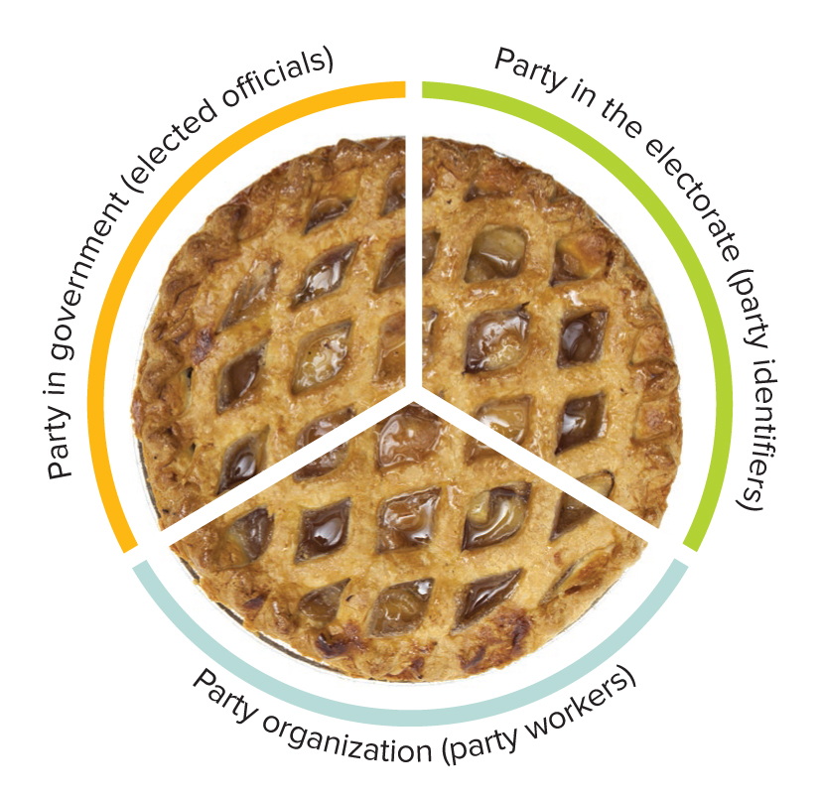
Figure 8.2 The Three Faces of Parties
American political parties perform their various functions through three “faces,” or spheres of operation.
SOURCE: Creativeye99/iStock/Getty Images

Slide 11
The Party in the Electorate
Party in the electorate: all those who identify with or tend to support a particular party.
Party identifier: an individual who identifies himself or herself as a member of one party or the other; party identifiers typically are measured by party registration.
Independent: a voter who does not belong to any organized political party; often used as a synonym for an unaffiliated voter.
Party in the electorate also includes those individuals who express a tendency to vote for one party or a preference for that party.

Slide 12
Determining Who Belongs to Each Political Party
Whites, men, people with some college education, upper-middle class individuals, and conservatives are more likely to be Republicans.
Key voting blocs for the Democrats include African Americans, Hispanics, working class individuals, women, liberals, and people with no college education.

Slide 13
Differences Between Democrats and Republicans 1
Democratic agenda includes civil rights, equal rights, social welfare programs, immigration reform, gay and transgender rights, and freedom of choice with respect to abortion.
Republican agenda includes smaller government, fewer social welfare functions, advocating traditional moral values, pro-life and pro-business policies, and a larger role for state governments.

Slide 14
Differences Between Democrats and Republicans 2
Democratic Party’s base prominently includes women and minorities.
Republican Party’s base prominently includes business owners, the very religious, upper-middle-class voters, and rural voters who have not attended college.
Parties have a few similarities but also important differences, such as what are perceived as the nation’s most pressing problems.

Slide 15
Table 8.1 In What Areas Should the Government Play a Major Role? Differences and Similarities Among Democrats and Republicans
GOVERNMENT SHOULD PLAY A MAJOR ROLE IN… | REPUBLICAN/ LEAN REPUBLICAN | DEMOCRAT/ LEAN DEMOCRAT | REPUBLICAN-DEMOCRAT DIFFERENCE
Ensuring access to health care | 39% | 86% | 47%
Helping people get out of poverty | 44% | 80% | 36%
Protecting the environment | 45% | 80% | 35%
Ensuring access to quality education | 57% | 89% | 32%
Setting workplace standards | 51% | 75% | 24%
Ensuring basic income for 65+ | 58% | 71% | 13%
Strengthening the economy | 73% | 76% | 3%
Maintaining infrastructure | 69% | 76% | 7%
Ensuring safe food and medicine | 83% | 92% | 9%
Responding to natural disasters | 86% | 90% | 4%
Keeping country safe from terrorism | 92% | 98% | 6%
Managing the immigration system | 78% | 86% | 8%
Table divided into two columns summarizes differences and similarities among Democrats and Republicans. Column 1 notes points of differences and similarities. Column 2, percent who say government should play a major role, is further divided into 3 sub-columns as: Republican or lean Republican, Democrat or lean Democrat, and Republican-Democrat difference.
SOURCE: Pew Research Center, “Government Gets Lower Ratings for Handling Health Care, Environment, Disaster Response,” Pew Research Center, Washington, DC (November, 2015).

Slide 16
The Party Organization
Party organization: the formal party apparatus, including committees, headquarters, conventions, party leaders, staff, and volunteer workers.
Theoretically, parties’ organization resembles a pyramid.
In reality, the national committees exist separately from the committees of the state and local parties.
Real political power can usually be found at the local or county party level.

Slide 17
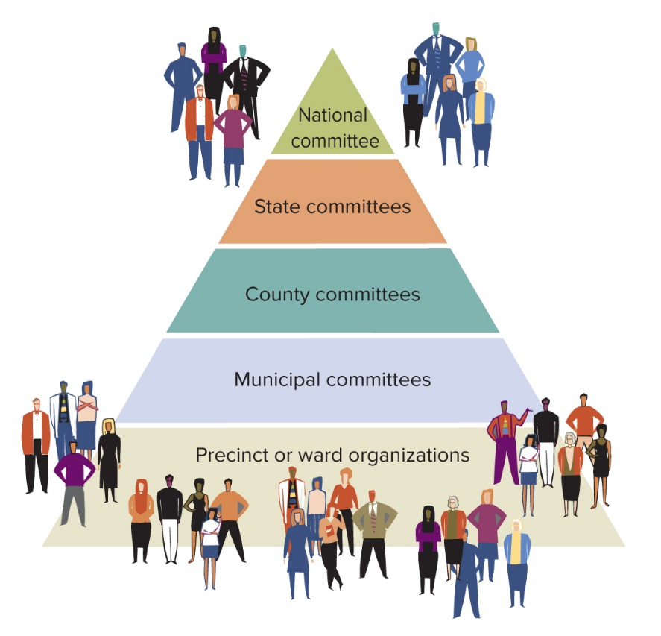
Figure 8.3 Theoretical Structure of Political Parties: A Hierarchical Model of Party Organizations
Theoretically, political parties’ organization resembles a pyramid, with a broad base of support at the bottom and power flowing up to a smaller group at the state level and then to an even smaller, more exclusive group at the national level.
Access the text alternative for slide images.

Slide 18
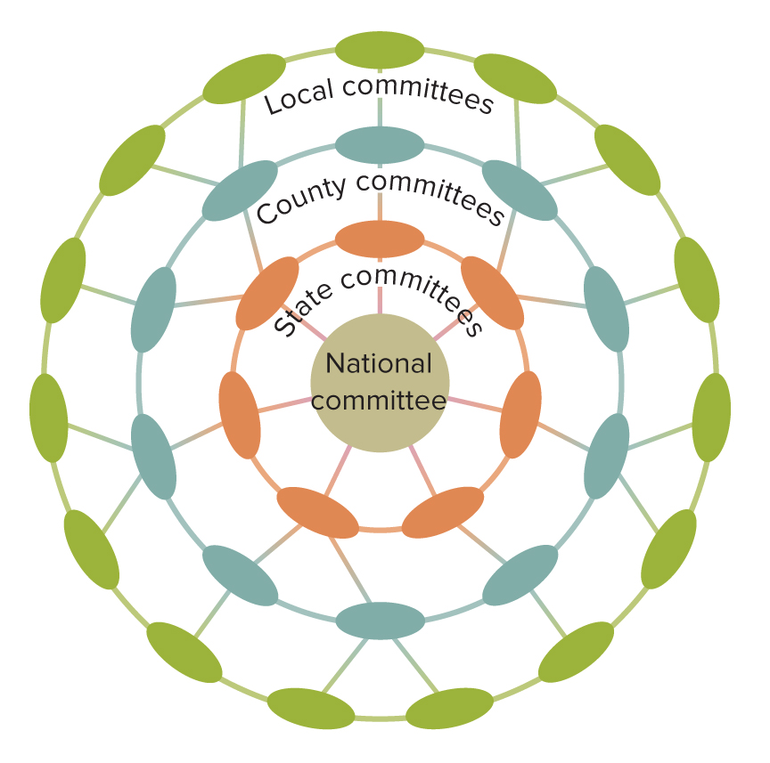
Figure 8.4 Modern Structure of Political Parties: Power Diffused Through Many Party Organizations
The pyramid model is insufficient, because in reality, real political power can usually be found at the local or county level. Here, multiple centers of power interact in a more complex web.
Access the text alternative for slide images.

Slide 19
National Parties 1
Every four years, political party activists meet at a national convention to determine their party’s nominee for the presidency.
National party committees are the national party organizations charged with conducting the conventions and overseeing the operation of the national party during the interim between conventions.

Slide 20
National Parties 2
National committee elects a national chair.
National chair, along with the paid staff of the national committee, oversees the day-to-day operations of the political party.
One of the most important roles of the national chair has been to raise funds.
When a major party is out of power it plays the role of the loyal opposition by objecting to the policies and priorities of the party in power.

Slide 21
State Parties
Both national parties have committees in each state that effectively are the party in that state.
State committees act as intermediaries between the national committees and county committees.
Typically, state committees are made up of a few members from each geographical subdivision of a given state.
Soft money loophole in campaign finance law was created by the ruling in Buckley v. Valeo (1976).
Political parties could raise unlimited funds for party-building activities; but this loophole was ultimately eliminated by the Bipartisan Campaign Reform Act of 2002.

Slide 22
County and Local Parties
County committees consist of members of municipal, ward, and precinct party committees.
County committees help recruit candidates for office, raise campaign funds, and mobilize voters.
In most major cities, ward committees and precinct committees dominate party politics.

Slide 23
The Party in Government
Party in government: the partisan identifications of elected leaders in local, county, state, and federal government.
Party in government significantly influences the organization and running of the government at these various levels.

Slide 24
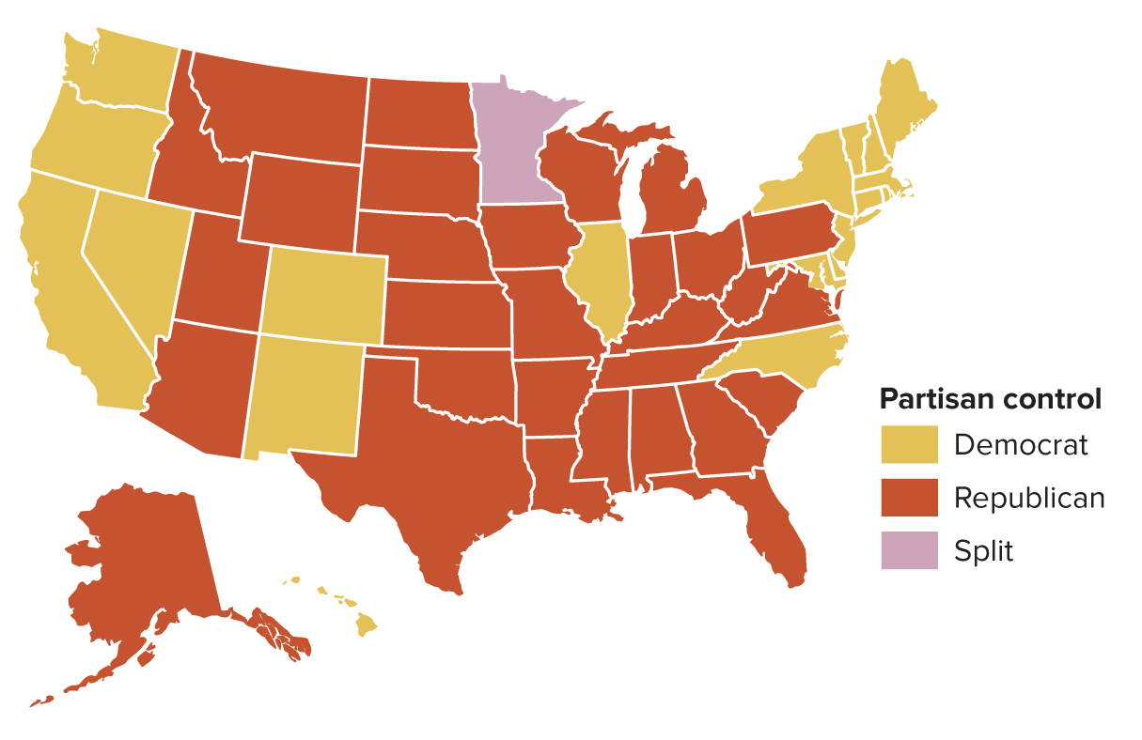
Figure 8.5 Partisan Control of State Legislatures
Access the text alternative for slide images.
SOURCE: “Partisan composition of state legislatures.” Ballotpedia. https://ballotpedia.org/Partisan_composition_of_state_legislatures.

Slide 25
Divided Government
Divided government: when one party controls both houses of Congress and the other party, the presidency.
Truncated government: when one party controls only one house of Congress and the presidency.
Barack Obama, George W. Bush, and Bill Clinton all faced a divided government at some point in their presidencies.

Slide 26
Political Parties in U.S. History
Party system: the categorization of the number and competitiveness of political parties in a polity.
Demarcation of party systems typically occurs when social scientists recognize points where there has been realignment, a shift in party allegiances or electoral support.

Slide 27
The First Party System: The Development of Parties, 1789 to 1828 1
In 1788, George Washington was elected president, but the consensus surrounding his election was short-lived.
Alexander Hamilton and the loosely-knit Federalist Party favored a strong national government.
Jefferson and his backers who feared a strong national government were in opposition.

Slide 28
The First Party System: The Development of Parties, 1789 to 1828 2
Jefferson’s triumph in the election of 1800 marked the end of the Federalist Party.
Jefferson’s supporters became known as Jeffersonian Republicans; later, Democratic-Republicans.
The modern descendants of the Democratic-Republicans today are called Democrats.
Era of Good Feelings (1815 to 1828) saw widespread popular support for Democratic-Republican presidents James Madison, James Monroe, and John Quincy Adams.

Slide 29
The Second Party System: The Democrats’ Rise to Power, 1828 to 1860
Jacksonian Democrats espoused populism and the spoils system.
Populism succeeded in mobilizing the masses and taking Jackson to presidential victory in 1828.
Jackson rewarded his political supporters with jobs (spoils).
Economic elites founded the Whig Party in 1836.
Represented the interests of southern plantation owners and northern industrialists against populism.
Second party system saw the politicization of a previously excluded mass of citizens.

Slide 30
The Third Party System: The Republicans’ Rise to Power, 1860 to 1896 1
In the 1850s, slavery became the primary concern for both the Whigs and the Democrats.
New antislavery party, the Republicans, formed in 1854 and gained the support of abolitionist Whigs and northern Democrats.
Lincoln’s victory in the election of 1860 began a period of dominance for the antislavery Republicans.

Slide 31
The Third Party System: The Republicans’ Rise to Power, 1860 to 1896 2
“Party of Lincoln” enjoyed decades of support from newly enfranchised African American voters.
Political machines came to dominate the big-city political landscape during this period.
Both corrupt and useful.
Each headed by a boss whose power rested on patronage.
Patronage system rewarded political machine supporters with jobs and government contracts.

Slide 32
The Fourth Party System: Republican Dominance, 1896 to 1932
Election of 1896 ushered in an era of Republican dominance that would last until the election of 1912.
In the 1912 presidential election Theodore Roosevelt ran as a Progressive.
Republican vote split between Taft and Roosevelt and gave Democrat Woodrow Wilson the presidency.
Many of the Progressives’ reforms were enacted during Wilson’s presidency.
After Wilson’s two terms, the Republicans retained control of the presidency throughout the 1920s.

Slide 33
The Fifth Party System: Democratic Dominance, 1932 to 1968 1
Franklin D. Roosevelt (FDR) was elected president in 1932.
His New Deal was a broad program in which the government would bear the responsibility of providing a safety net to protect the most disadvantaged members of society.
He was supported by a New Deal coalition.
Southern Democrats, northern city dwellers, Catholics, unionized and blue-collar workers, African Americans, and women.

Slide 34
The Fifth Party System: Democratic Dominance, 1932 to 1968 2
Era of the Fifth Party System significantly opened up party politics and civic activity to more Americans.
FDR’s elections marked the first time that women and African Americans were courted by political parties.
Eisenhower was the sole Republican president of the era.
Democrats won the White House in 1960 and 1964, but events of the decade wreaked havoc on the party.
Deep divisions over the Vietnam War and civil rights for African Americans.

Slide 35
A New Party System?
Donald Trump’s election in 2016 raises the question as to whether a new party system is emerging.
Support for the idea:
Six Republican presidents since 1968.
Southern whites switching from Democrat to Republican.
Conservative Christians active in Republican politics.
Additional characteristics of this new party system include intense party competition and divided government.

Slide 36
The Party System Today: In Decline, in Resurgence, or a Post-Party Era?
Do the changes signify an end to party control in American politics?
Can political parties adapt to the altered environment and find new sources of power?

Slide 37
The Party’s Over
Some scholars note the declining power of political parties make them essentially impotent.
Party loyalty has decreased.
Elimination of political patronage and spoils.
Government has a greatly increased role in providing social welfare benefits that had previously been a function of the parties.
Primary elections: voters, not party bosses, choose candidates.
Voters now rely on media sources for information.
Candidate-centered campaigns, where the individual is the focus and not the party slate, have further weakened parties.
Citizens United v. FEC paved the way for an explosion of campaign spending by independent groups.

Slide 38
The Party’s Just Begun
Others disagree that parties’ prime has passed.
According to this view, the parties’ ability to rebound is alive and well.
These scholars argue that continued dominance of two political parties in the United States is likely.
Scholars also cite the lack of viable alternatives to the two-party system.

Slide 39
A Post-Party Era?
Notable characteristics of a new party system:
Dealignment: voters identifying as independent.
Ticket splitting: voting for candidates of more than one party.
Candidate-centered politics have grown in importance since 1968.
Rise of candidate committees: organizations candidates form to support their individual election.

Slide 40
Two-Party Domination in U.S. Politics
Since the ratification of the Constitution in 1787, the United States has had a two-party system for all but about 30 years.
Third party: a political party organized as opposition or an alternative to the existing parties in a two-party system.

Slide 41
The Dualist Nature of Most Conflicts
Historically, many issues in the United States have been dualist, or “two-sided.”
Political scientists Seymour Martin Lipset and Stein Rokkan asserted that the dualist nature of voter alignments or cleavages shapes how political parties form.
Today, the national debate on immigration reform continues to provide evidence of the dualist nature of much of American political discourse.

Slide 42
The Winner-Take-All Electoral System
Most U.S. elections are winner-take-all.
Candidate with the most votes wins.
Winner need not have a majority of the votes.
In a proportional representation system, political parties win the number of parliamentary seats equal to the percentage of the vote each party receives.

Slide 43
Continued Socialization to the Two-Party System
Party identification—like ideology, values, and religious beliefs—is an attribute that often passes down from one generation to the next.
Even children who do not share their parents’ political outlook have usually been socialized to the legitimacy of the two-party system.

Slide 44
Election Laws That Favor the Two-Party System
At both the federal and the state level in the United States, election laws benefit the two major parties because they are usually written by members of one or both of those parties.
Third parties have a much steeper climb to get their candidates in office—sometimes, just getting a candidate’s name on the ballot is a serious challenge.

Slide 45
Third Parties in the United States 1
One of the most significant obstacles to the formation of a viable third party is that the people who are dissatisfied with the two dominant parties fall across the ideological spectrum.
About 60 percent of Americans say they think a third party is needed, but they differ as to what that party should stand for.
As a result, third parties have had little success in contesting elections.

Slide 46
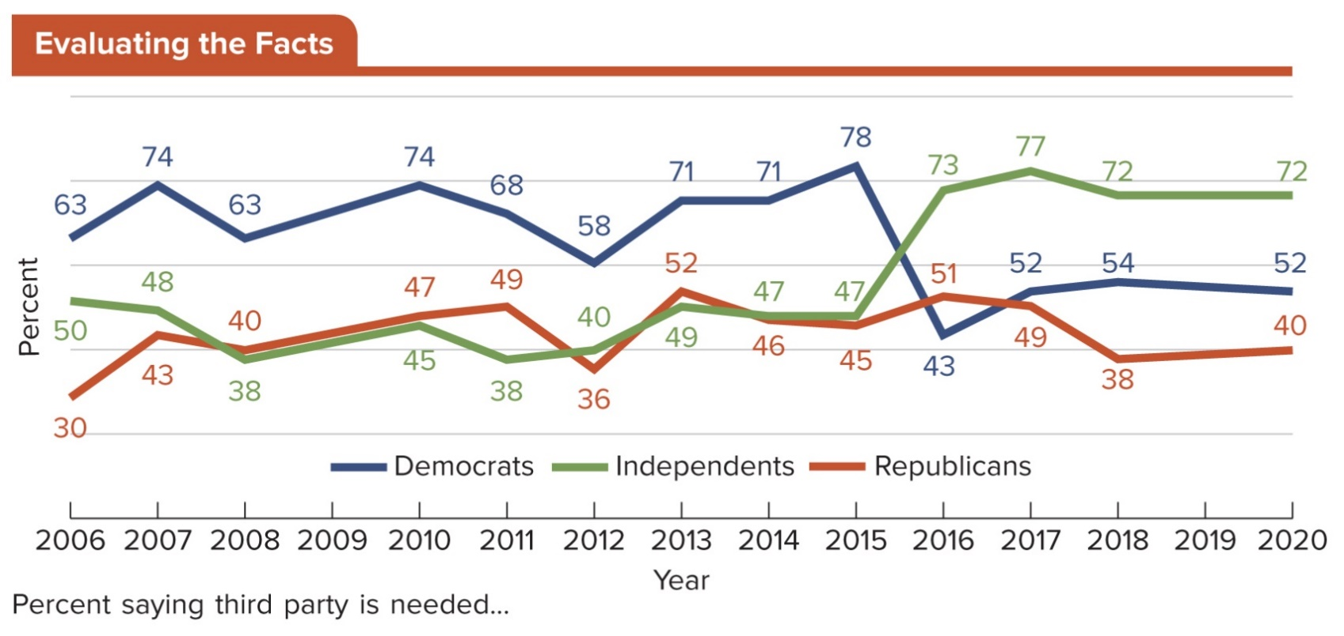
Figure 8.6 Support for a Third Party by Party Identification
This graph presents responses to the following question: “In your view, do the Republican and Democratic parties do an adequate job of representing the American people, or do they do such a poor job that a third major party is needed?”
Access the text alternative for slide images.
SOURCE: Gallup, “Majority in U.S. Need for Third Party,” 2018.

Slide 47
Third Parties in the United States 2
Third parties have played, and continue to play, an influential role in American electoral politics; even the threat of forming a third party is enough.
Republicans feared that if Donald Trump lost the primary he would run in the general election as an Independent.

Slide 48
Types of Third Parties
Third parties have existed in the United States since the early 19th century.
Third parties typically fall into one of three general categories.
Issue advocacy parties.
Ideologically oriented parties.
Splinter parties.

Slide 49
Issue Advocacy Parties
Because they are formed to promote a stance on a particular issue, many issue advocacy parties are short-lived.
Once the issue is dealt with or fades from popular concern, the mobilizing force behind the party disintegrates.

Slide 50
Ideologically Oriented Parties
Agenda of an ideologically oriented party is typically broader than that of an issue-oriented party.
Examples of ideologically oriented parties:
Libertarian Party.
Socialist Party.

Slide 51
Splinter Parties
Splinter party is a political party that breaks off, or “splinters,” from one of the two dominant parties.
States’ Rights Party in 1948 was a splinter party.
Also known as the Dixiecrat Party.
Opposed the Democratic Party’s support of civil rights for African Americans.

Slide 52
The Impact of Third Parties
Although third parties usually do not win elections, they can influence electoral outcomes.
Some believe that in the 2000 presidential race, Green Party candidate Ralph Nader cost Al Gore the election.
Third parties provide:
A release valve for dissatisfied voters.
A means to bring national attention to variety of issues.
Third parties sometimes fold when their central ideology is co-opted by an existing major party.

Slide 53
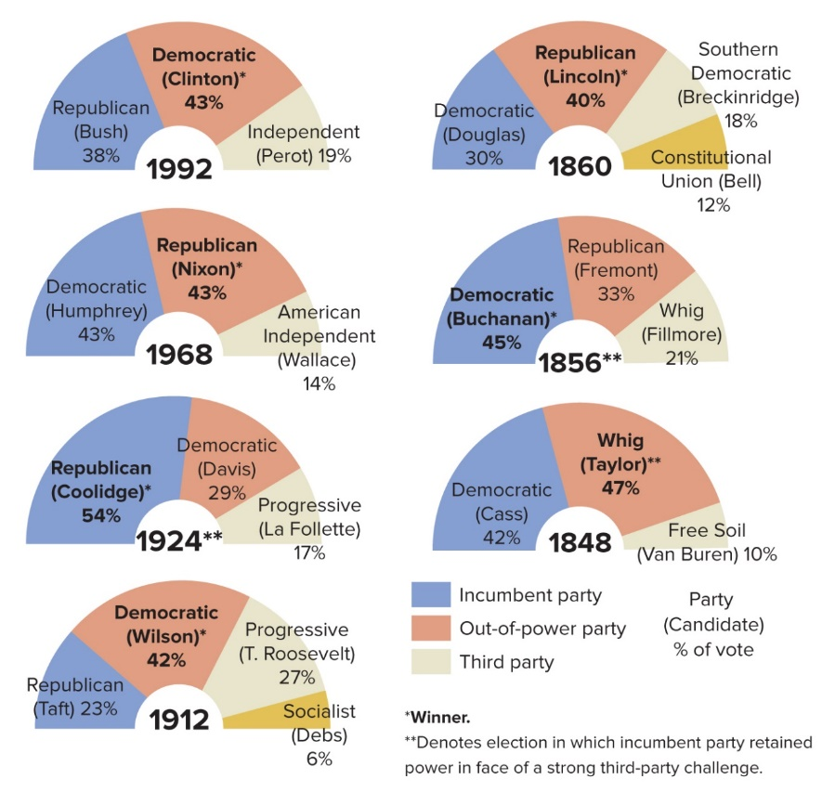
Figure 8.7 Third Parties Help the Out-of-Power Party
At the national level, third parties were a release valve for discontented voters in several elections.
Access the text alternative for slide images.

Slide 54
New Ideologies, New Technologies: The Parties in the 21st Century
American political parties have changed dramatically in recent years.
Global events such as the COVID-19 pandemic and its aftermath, the rise of international and domestic terrorism and multifront wars, and the impact of the Internet and cellular technologies have partly driven the changes.
Today, dominant issues include economic aftermath of COVID-19, including domestic job creation; and Democratic and Republican positions are distinct.

Slide 55
Republicans Today: The Establishment, President Trump, and the Tea Party
Republican Party faces a battle for the soul of the party on several fronts.
Donald Trump.
Alienation of groups the party was trying to woo.
Inconsistencies in policy positions.
Divisions between stanchly conservative activists and more moderate members of the party.
Tea Party movement.

Slide 56
A Battle for the Soul of the Democratic Party Today
Tensions have grown between factions in the Democratic Party.
Moderate Democratic nominee Joe Biden.
Some of the more progressive members of the party.
Tensions continue to be pronounced today, even while Democrats have solidified in their opposition to President Trump’s agenda.

Slide 57
Changing Both Parties: New Technologies
Parties are increasingly using new technologies and “big data” to target potential supporters.
Democrats work with NGP VAN.
Republicans work with Aristotle.
Companies collect data from different sources, both public and private.
Political parties increasingly connect with potential supporters via social media, YouTube, and campaign websites.

Slide 58
Review 1
Then—Political parties relied on patronage and voter loyalty to become powerful entities in American politics.
Now—The United States seems deeply divided, with rampant partisan rancor.

Slide 59
Review 2
Next:
Will the dominance of the Democratic and Republican Parties continue?
Will moderates continue to feel the pressure from the more ideological wings of their parties?
How will digital technologies further shape parties’ strategies and expand their reach—and change the membership of parties?

Slide 60
End of Main Content
Copyright 2022 © McGraw Hill LLC. All rights reserved. No reproduction or distribution without the prior written consent of McGraw Hill LLC.

Slide 61
Accessibility Content: Text Alternatives for Images

Slide 62
Figure 8.1 The People’s Opinion of Democrats and Republicans - Text Alternative
Return to parent-slide containing images.
Line graph shows the favorability rating for the democratic at the Republican Party with the following data: Democratic Party: 1990 552%, 1997 60%, 1999 57%, 2061%, 2004 47%, 2005 52%, 2006 52%, 2007 57%, 2009 55%, 2013 43% 2015 43%, 2016 44%, 2017 44%, 2018 44%. Republican Party: 1995 51%, 1997 50%, 1999 31%, 2053%, 2002 61%, 2003 55%, 2005 56%, 2006 40%, 2007 35%, 2009 34%, 2014 28%, 2015 38%, 2000 1639%, 2017 36%, 2018 45%.
Return to parent-slide containing images.

Slide 63
Figure 8.3 Theoretical Structure of Political Parties: A Hierarchical Model of Party Organizations - Text Alternative
Return to parent-slide containing images.
Illustration of a triangle showing the hierarchical structure of political parties. Precinct or ward organizations are at the bottom, followed by municipal committees, county committees, state committees and finally national committees are at the top. As one moves up from the top to the bottom of the triangle, the number of committees within a level become fewer (for instance there are fewer state committees than county committees), however the power held by those committees increases.
Return to parent-slide containing images.

Slide 64
Figure 8.4 Modern Structure of Political Parties: Power Diffused Through Many Party Organizations - Text Alternative
Return to parent-slide containing images.
Infographic showing that each of the major levels of a political party: local, county, state and national committee each have a number of individual components that must coordinate and cooperate with one another. For example, the various county parties must interact and coordinate with one another as well as the various fifty state committees.
Return to parent-slide containing images.

Slide 65
Figure 8.5 Partisan Control of State Legislatures - Text Alternative
Return to parent-slide containing images.
Map of the United States shows partisan control of state legislatures in 2018. Republican control existed throughout the South, Virginia, West Virginia, Kentucky, Pennsylvania, Ohio, Indiana, Michigan, Wisconsin, Iowa, Missouri, Kansas, the Dakotas, Montana, Wyoming, Idaho, Utah, Arizona, and Alaska. Control was split in Minnesota, and data on available for Nebraska. The other states are controlled by Democrats.
Return to parent-slide containing images.

Slide 66
Figure 8.6 Support for a Third Party by Party Identification - Text Alternative
Return to parent-slide containing images.
Line graph shows support for third-party identification. Support for third-party was strongest amongst Democrats from 2006 two 2015 then dropping precipitously from 78 to 43%. Republicans generally less enthusiastic about the third-party challenge, with support for the idea ranging between 30% in 2006 and 52% in 2013. Support for third-party challenge fluctuated between thirty-eight and 50% for independence, surging to seventy-three and 77% in 2016 and 2017 respectively.
Return to parent-slide containing images.

Slide 67
Figure 8.7 Third Parties Help the Out-of-Power Party - Text Alternative
Return to parent-slide containing images.
Election of 1848: The out-of-power Whig Party (candidate: Taylor) took the election with 47% over the incumbent Democratic Party’s 42% (candidate: Cass). A third party, the Free Soil Party (candidate: Van Buren), took 10%.
Election of 1856: The incumbent Democratic Party (Buchanan) retained power with 45%. The out-of-power Republican Party (Fremont) took 33% and the third party, the Whigs (Fillmore) took 21%.
Election of 1860: The out-of-power Republican Party (Lincoln) took the election with 40% over the incumbent Democratic Party’s 30% (Douglas). The Southern Democratic Party (Breckinridge) took 18%; and the Constitutional Union Party (Bell) took 12%.
Election of 1912: The out-of-power Democratic Party (Wilson) took the election with 42% over the incumbent Republican Party’s 23% (Taft). The Progressives (T. Roosevelt) took 27%; and the Socialist Party (Debs) took 6%.
Election of 1924: The incumbent Republican Party (Coolidge) retained power with 54%. The out-of-power Democratic Party (Davis) took 29% and the Progressives (La Follette) took 17%.
Election of 1968: The out-of-power Republican Party (Nixon) took the election with 43% over the incumbent Democratic Party’s 43% (Humphrey). The American Independent Party (Wallace) took 14%.
Election of 1992: The out-of-power Democratic Party (Clinton) took the election with 43% over the incumbent Republican Party’s 38% (Bush). Independent Ross Perot took 19%.
Return to parent-slide containing images.

